Slide 1
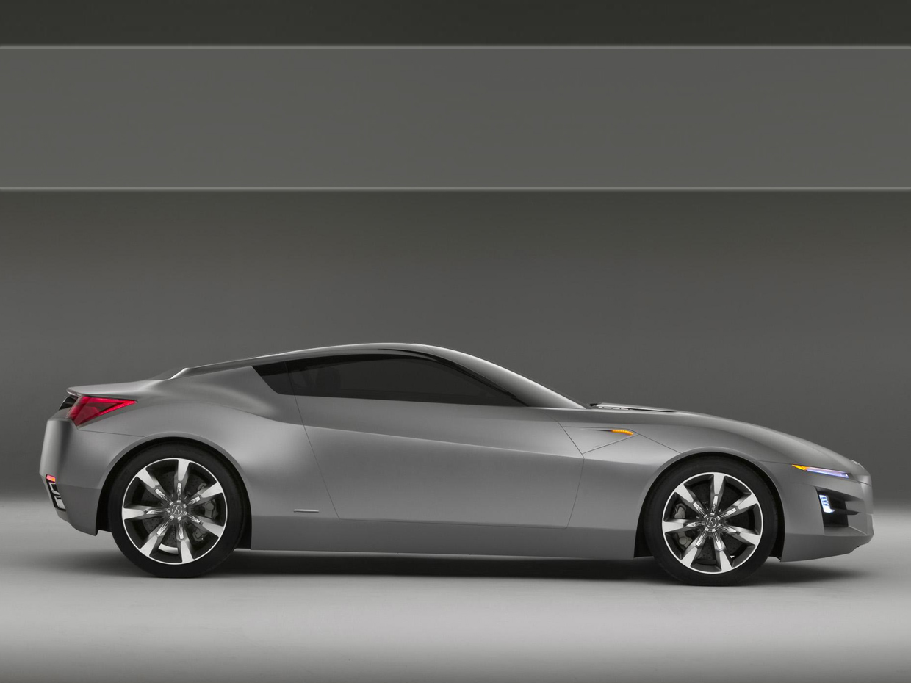
NPU CAR RENTALS

Slide 2
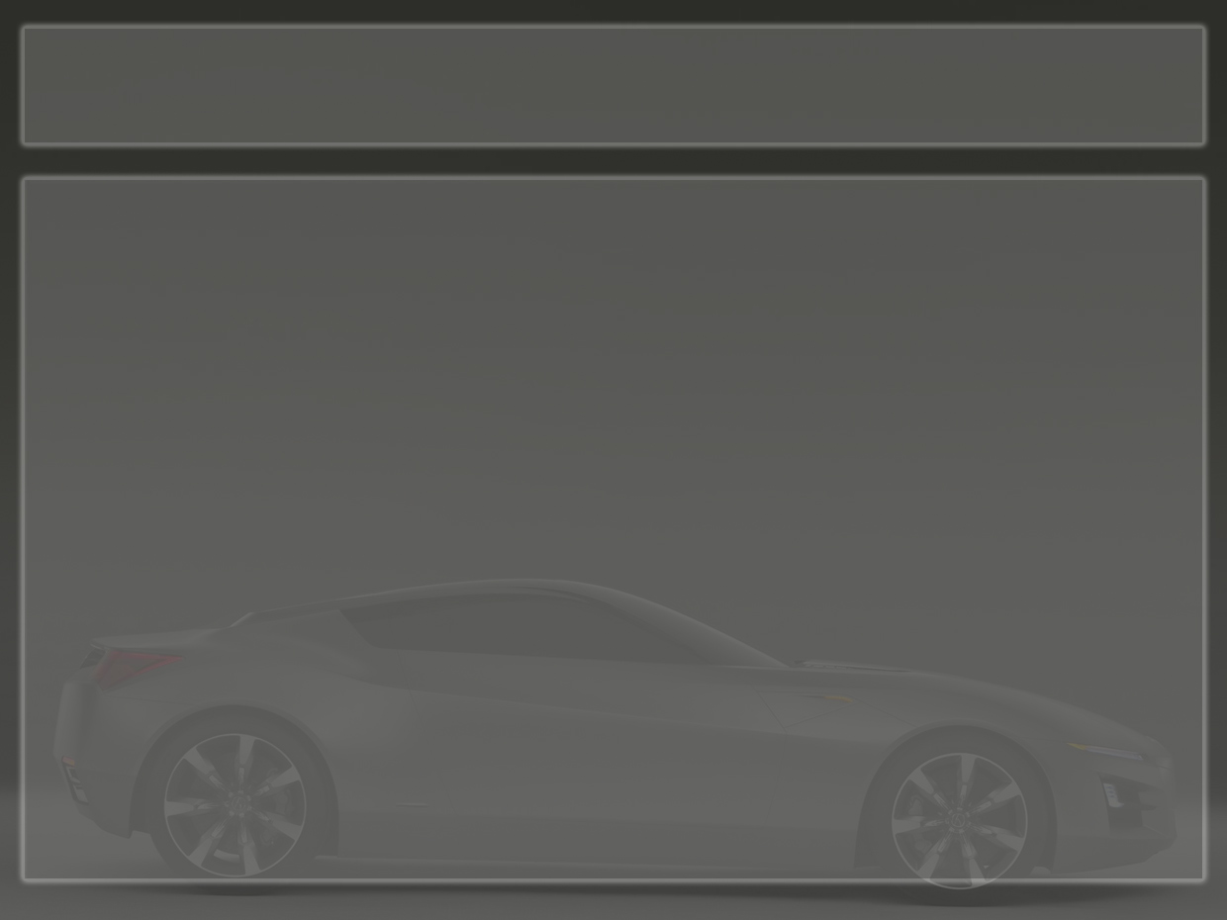
INTRODUCTION
This project is designed so as to be used by Car Rental Company specializing in renting cars to customers. It is an online system through which customers can view available cars, register, view profile and book car

Slide 3
PROJECT PROFILE
It’s a web-based system that allows customer to register and reserve car online and for the company to effectively manage their car rental business.
To ease customer’s task whenever they need to rent a car.

Slide 4
OBJECTIVES
This online car rental solution is fully functional and flexible.
It is very easy to use.
This online car rental system helps in back office administration by streamlining and standardizing the procedures.
It saves a lot of time, money and labor
Eco-friendly: The monitoring of the vehicle activity and the overall business becomes easy and includes the least of paper work.
The software acts as an office that is open 24/7.
It increases the efficiency of the management at offering quality services to the customers.
It provides custom features development and support with the software.

Slide 5
VISION & SCOPE
Our vision is to enhance our leadership stature, differentiate us from our competitors and bolster the cause of keeping the passenger vehicle economically viable and socially acceptable.
To be the best transportation service provider to exceed our customers' expectations for service, quality and value.

Slide 6
MILESTONES
Documentation
Requirement Gathering
Analysis
Design
Coding
Testing
Deployment

Slide 7

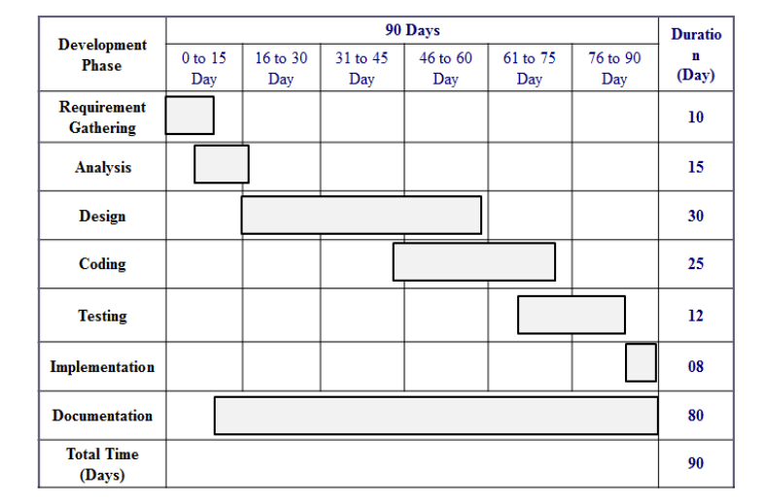
TIMELINE CHART

Slide 8
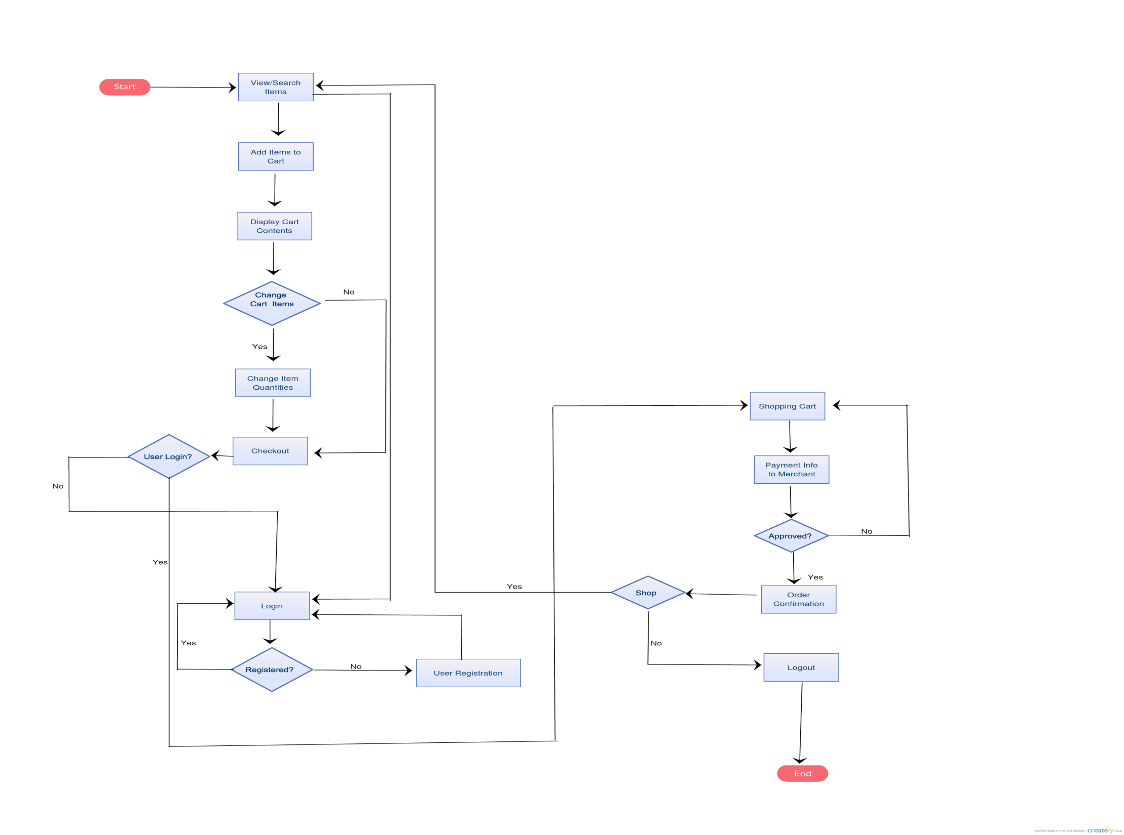
SYSTEM FLOW CHART

Slide 9
HARDWARE REQUIREMENT
Client Side
  RAM: 512 MB
  Harddisk: 10 GB
  Processor: 1.2 GHz
Server Side
  RAM: 1 GB
  Harddisk: 20 GB
  Processor: 2.0 GHz

Slide 10
SOFTWARE REQUIREMENT
Client Side
  Web Browser: IE, Chorome, Firefox
  Operating System: Windows or any equivalent OS
Server Side
  Database Server: MY SQL Server
  Web Browser: IE, Chorome, Firefox
  Operating System: Windows Server 2007

Slide 11
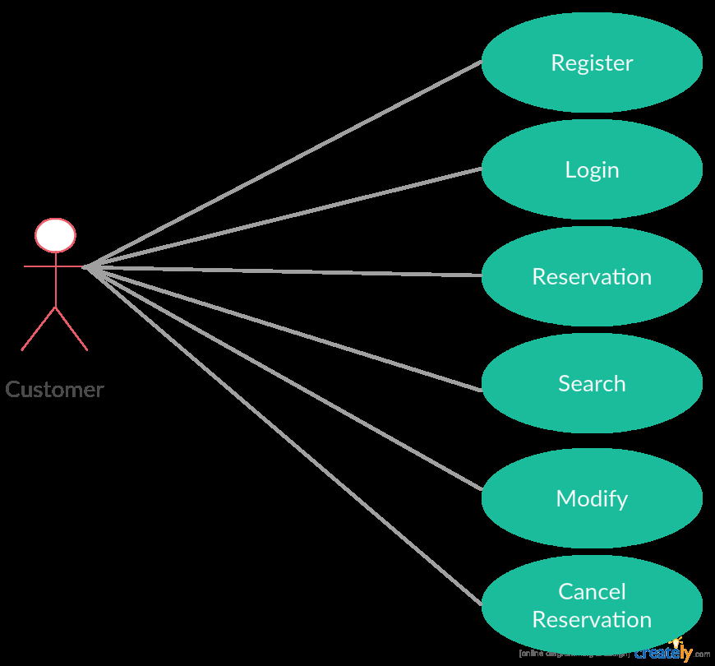
USE CASE DIAGRAM

Slide 12
FEATURES
Registration
Login
Car Reservation
Search Reservation
Modify Reservation
Cancel Reservation
Today's Deals
Popular Destinations
Advertisements
NPU Car Rental on Facebook

Slide 13
TESTING
Approach: Exploratory
Types of test conducted
  Smoke Test
  Functional Test
  Integration Test
  Regression Test
  System Test (Cross-browser, Compatibility, Performance)

Slide 14
FUTURE ENHANCEMENTS
Change Password
Forgot Password
Update User Profile
Reservation History
Feedback

Slide 15
BIBLIOGRAPHY
Book Reference
  Java: The Complete Reference by Herbert Schildt
Web Reference
  www.oracle.com
  www.w3schools.in
  www.javaranch.com
  www.mysql.com
  www.javaprogrammingforums.com

